Slide 1
Predictive Analysis Using Machine Learning Techniques
Sashank Sainath
Pooja Songadkar

Slide 2
Linear Regression
Linear regression is a statistical method used to model the relationship between one or more independent variables (predictors) and a dependent variable (outcome).
The relationship is represented by a linear equation, where the coefficients of the independent variables are estimated to minimize the sum of squared errors between the observed and predicted values.
Linear regression is widely used for prediction, inference, and understanding the relationship between variables.

Slide 3
Time Series Analysis
Time series analysis is a statistical technique used to analyze time-ordered data points collected at regular intervals. It involves identifying patterns, trends, and seasonality in the data to make predictions about future values.
Time series analysis encompasses various methods, including autoregressive integrated moving average , seasonal decomposition of time series , and exponential smoothing models.
It is commonly used in finance, economics, weather forecasting, and other fields where data is collected over time.

Slide 4
Naïve Bayes Classification
Predictive analysis using Naïve Bayes Classification is a common technique in machine learning for classification tasks.
Naïve Bayes is a probabilistic algorithm based on Bayes' theorem, which assumes that the presence of a particular feature in a class is independent of the presence of any other feature.
Despite its simplicity and the "naïve" assumption of feature independence, Naïve Bayes often performs surprisingly well in practice and is particularly suited for text classification and spam filtering.

Slide 5
Decision Tree
Predictive analysis using Decision Trees involves constructing a tree-based model that recursively partitions the feature space based on the values of input features, aiming to predict the target variable.
The algorithm selects the most informative features at each node to split the data, leading to an interpretable tree structure where each leaf node represents a prediction.
Decision Trees are advantageous for their ability to handle both numerical and categorical data, their interpretability, and their capacity to capture non-linear relationships between features and the target variable.

Slide 6
Random Forest
Random Forest involves employing an ensemble learning technique based on Decision Trees to make predictions across various domains.
Random Forest constructs a multitude of decision trees during training, where each tree is trained on a random subset of the training data and features
During prediction, each tree in the forest independently predicts the outcome, and the final prediction is determined by aggregating the votes or averaging the results from all the trees.
This approach improves predictive accuracy, reduces overfitting compared to a single decision tree, and provides insights into feature importance

Slide 7
Dataset Overview
The Titanic dataset is a classic dataset often used for practicing machine learning techniques, particularly for binary classification tasks. It contains information about passengers aboard the RMS Titanic, including whether they survived or not
A Customer Shopping dataset typically contains a wealth of information about customers, products, transactions, and interactions on an ecommerce platform.
Source: Kaggle

Slide 8
Data Loading
Loading the Titanic dataset into a DataFrame named 'df' using the seaborn library. The dataset contains information about passengers aboard the Titanic and Ecommerce dataset , commonly used for exploring data visualization and machine learning techniques.
Data Preprocessing / Feature engineering :
Data Cleaning:
Handled missing values by imputing using KNN imputer and removing the unnecessary column due to high null values in the dataset
Feature Transformation:
Encoded categorical variables using label encoding to prepare them for machine learning algorithms.
Outlier Management:
Detected and managed outliers using the Z-score method to enhance data integrity and analysis reliability.

Slide 9
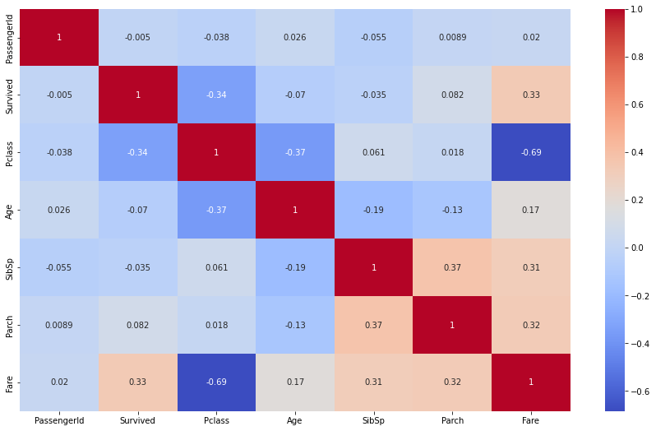
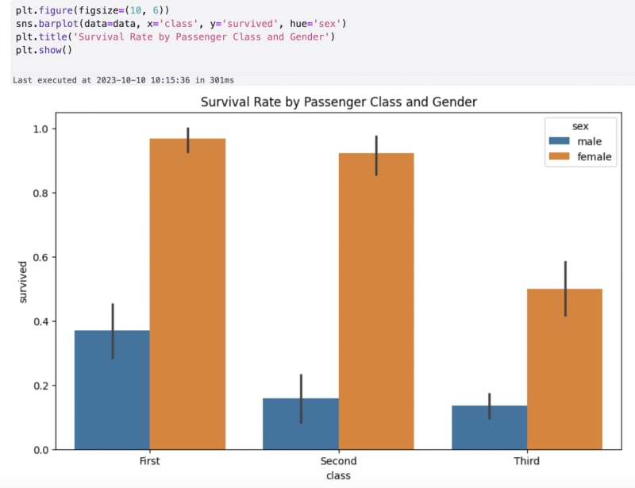
Data Visualization on the Datasets
A correlation matrix is a table which shows correlation coefficients between variables.
It helps identify relationships and dependencies among variables in a dataset.
Positive values indicate a direct relationship, negative values indicate an inverse relationship, and values close to zero suggest no correlation.
This matrix is useful for feature selection, identifying multicollinearity, and understanding the underlying structure of the data.

Slide 10
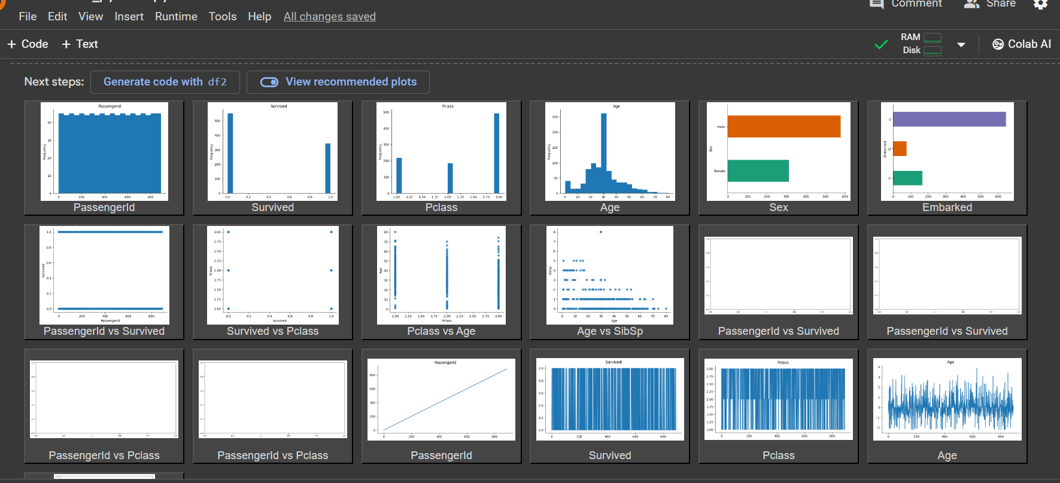

Slide 11
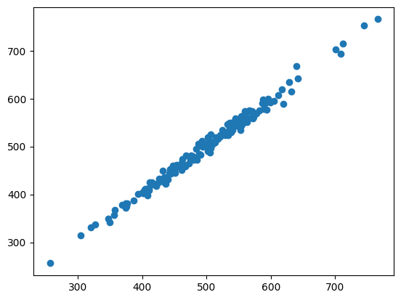
Linear Regression Scatter Plot
The majority of the data points are aligned along a diagonal line, indicating a positive correlation between the two variables i.e
X = Avg. Session Length, Time on App, Time on Website, Length of Membership
Y = Yearly Amount Spent
However, there are some outliers that do not follow the general trend of the data.

Slide 12
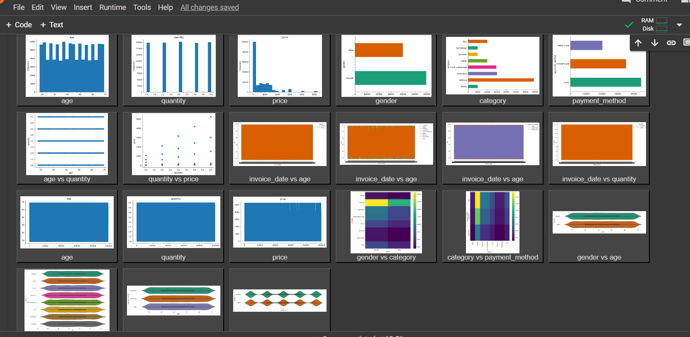

Slide 13
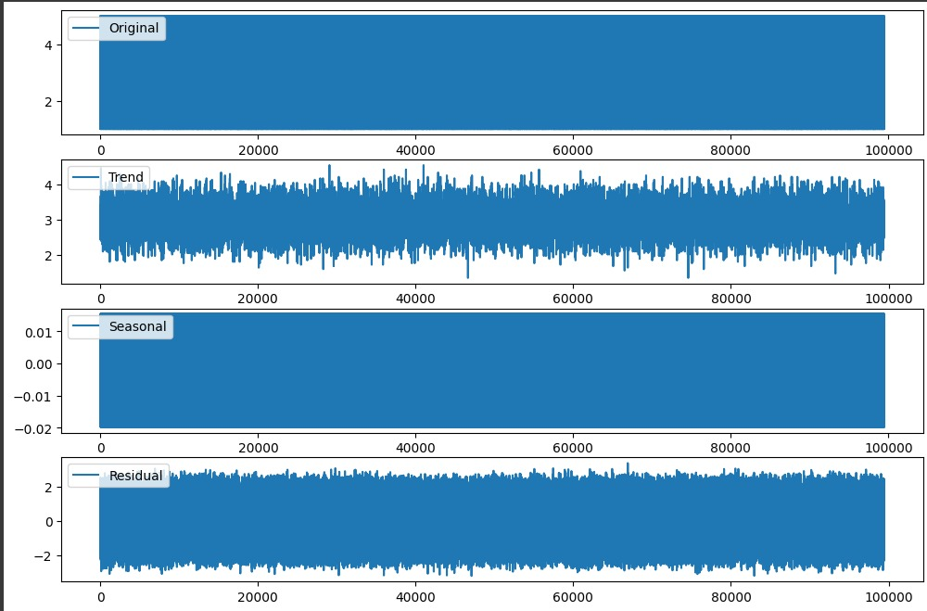
Time series analysis techniques
Time series analysis is
performed on the Ecommerce Dataset
Plotting the components for
Seasonal Decomposition

Slide 14
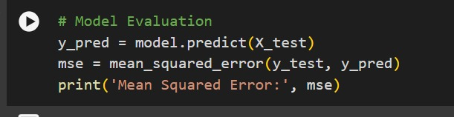
Model Evaluation
Mean Squared Error :The mean squared error in this case is approximately 5.164148672614108e-26

Slide 15
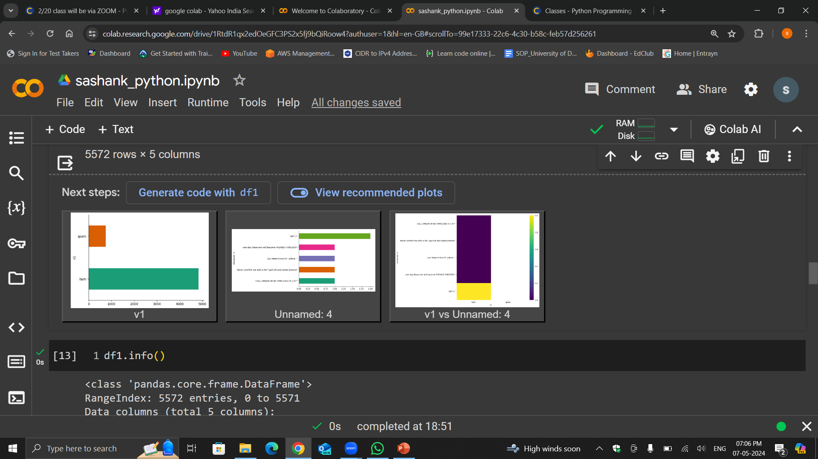
Naïve Bayes classifier on Spam Dataset

Slide 16
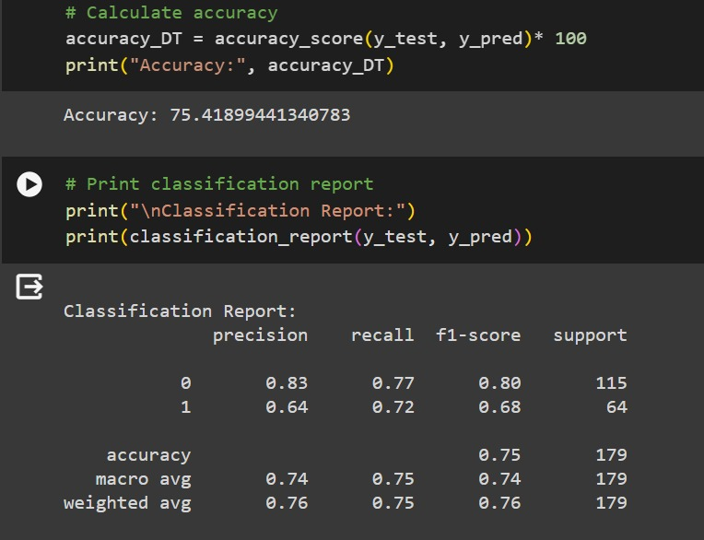
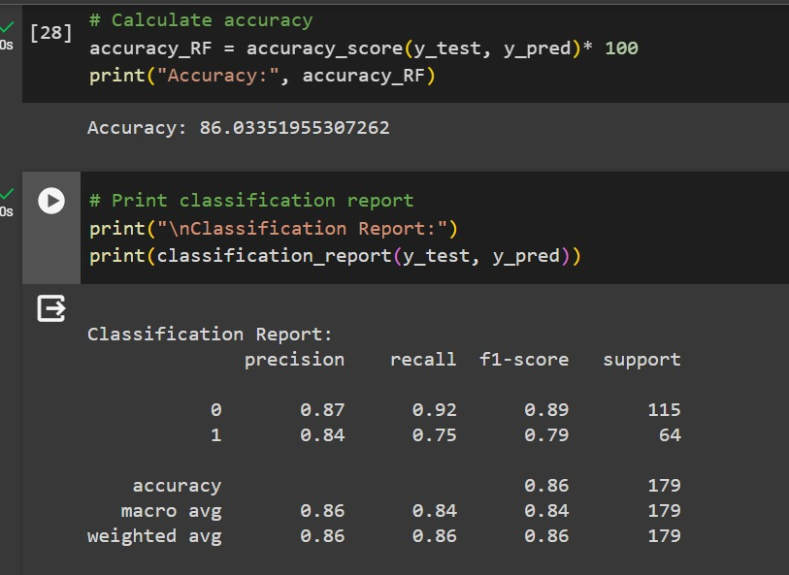
COMPARATIVE ANALYSIS OF MODEL METRICS: ACCURACY, PRECISION, RECALL, AND F1 SCORE Classification report for Decision Tree and Random Forest

Slide 17
Conclusion
In conclusion, this project has demonstrated the power of predictive analysis using machine learning techniques to extract actionable insights from data
By combining domain knowledge, analytical skills, and advanced machine learning algorithms, we have empowered decision-makers with the tools and insights needed to drive informed decisions and address complex challenges effectively.
While this project has provided valuable insights and predictive models, there are opportunities for further refinement and expansion. Future steps may involve refining the models through hyperparameter tuning, incorporating additional features or datasets for improved accuracy, or deploying the models in real-world applications for decision support.

